Slide 1


SEICHE 2023 Intermediate Arduino Programming for IoT
Instructor: Paul Frommeyer
www.paulfrommeyer.com
Corporate Sponsor: DXC Technology

Slide 2
REMINDER YOU MUST HAVE A WORKING LED MATRIX DISPLAY TO TAKE THIS CLASS! If displays are lost or damaged, replacements are $70 with 1-week lead time for replacement

Slide 3
Lesson Plan Overview
Lesson 1: 7Feb23 – Review, Addressing, and Pointers
Overview of lesson plan
Class Exercise: Validation of sketch uploading
Class Exercise: Validation of binary create and upload
More on the Preprocessor
Memory Organization and Variables
Review of addressing and pointers
Using pointers to variables
Declaring pointers in function calls
Call-by-value Function Calls
Call-by-reference Function Calls
Lesson 2: 14Feb23 – More Gory Details
Class Exercise: Call-by-reference variables
Introduction to Complex Data Structures
Using complex data structures
Storage declarations and Arduino
Lesson 3: 21Feb23 – Fonts Redux
MD_Parola library font usage review
The MD_Parola font format
Designing your own fonts
Declaring your own fonts
Using your own fonts with MD_Parola
Lesson 4: 28Feb23 – Intro to Visual Studio Code
Introduction to VSC
https://code.visualstudio.com/docs/introvideos/overview
VSCode Installation
VSCode Integration with Arduino and ESP8266
Lesson 5: 7Mar23 – Filesystems
Introduction to mass storage filesystems
The SD FAT, FAT16, and FAT32 filesystems
The exFAT filesystem
Introduction to SPIFFS
Class Exercise: Using SPIFFS
Lesson 6: 21Mar23 – WiFi
Review of WiFi technology (but no gory details)
Class Exercise: Review of WiFi access with WiFi Manager
Web server and client HTTP architecture
Introduction to HTML
Creating a basic ESP8266 web server
Lesson 7: 28Mar23 – Web Technology
More on HTML tags
HTTP and Mime Types
Using SPIFFS
Class Exercise: Display A Web Page
Lesson 8: 4Apr23 – Doing More With Web Servers
HTML Form Data
Asynchronous Web Server Installation
Class Exercise: Displaying Sensor Data With Async Web Server
Class Exercise: Retrieving Form Data with Async Web Server
Lesson 9: 11Apr23 – Wifi Manager, API’s, Web Scraping
Class Exercise: Displaying form data with MD_Parola
APIs
Web Scraping
Lesson 10: 18Apr23 – JSON and REST API’s
Introduction to JSON
Using JSON with Arduino
Using REST with Arduino
Lesson 11: 25Apr23 – Internet Access
Git and Github Quick Tour
Class Exercise – Marquee Scroller Software
Obtaining weather information from the Internet
Class Exercise: Obtaining weather and news API keys
Lesson 12: 2May23 – API Keys and Gradution
Class Exercise: Getting and displaying weather information
Trimester Review and Graduation

Slide 4

Flash Drive Contents Reminder
When I update parts of your flash drives, you can either recopy the entire section, or just copy the updated part.
However, you will need to explicitly copy any new files so that they are locally accessible on your laptops
Copying just lesson files will– wait for it!– copy only the lesson files.
Make certain you have copied everything in RED! You should already have previously copied everything else!
FLASH DRIVE
IntermediateProgramming-Software
Archive–BasicProgrammingWith Arduino-Fall2022
Archive-IntroductionToArduino-Spring2022
IntermediateProgramming-Software
IntermediateProgramming-Lessons
IntermediateProgramming-Documentation
ESP8266FS-0.5.0.zip
IntermediateProgramming-Lessons
IntermediateProgramming-Documentation
IntermediateProgramming-Lesson1
IntermediateProgramming-Lesson2
IntermediateProgramming-Lesson3
IntermediateProgramming-Lesson11
ArduinoReference
Beginning C for Arduino, 2nd Edition
BoardsGuides
D1 Mini Reference
ElectronicsReference
IoT Reference
LED Matrix Display Architecture
HackSpace Magazine
Can’t do reading homework without the files!

Slide 5
Lesson 12 – API Keys and Graduation
Part A
Review: Marquee Scroller
Review: Uploading binary files with ESPtool
Obtaining API keys walkthrough
Openweathermap
News API
Part B
Trimester Review
Introduction to Arduino
Basic Arduino Programming
Intermediate Arduino Programming
Paul’s Github Page
Graduation
Certificates
Recognition Awards

Slide 6
CLASS EXERCISE – Marquee Scroller
Marquee Scroller is software written by Github member “Qrome”. It is available at https://github.com/qrome/marquee-scroller
Review of main project homepage
Author and project
Number of forks and favorites
File being browsed
Project Document List
File browse display
Source: https://github.com/qrome/marquee-scroller

Slide 7
Marquee Scroller (cont.)
As we might expect, Marquee Scroller requires a set of libraries. These are documented in the README.md on Github
However, for those of you who were not here last week, you can cheat and just load the binary directly using ESPtool!
Source: https://randomnerdtutorials.com/decoding-and-encoding-json-with-arduino-or-esp8266/

Slide 8
Recap: Flashing Software Binaries
The Arduino IDE takes Processing/C++ source code and compiles it into a single binary file which is then transmitted to the microcontroller where it is stored in flash memory
Uploading of “raw” binary executable files to a microcontroller is called “flashing”
It is possible to create precompiled binaries and flash them without having to compile from source code or use the Arduino IDE
This is very, very similar to installing an app on a phone (and is identical to initially installing the operating system onto a phone, which is done at the factory)
We are going to learn how to do this ourselves!

Slide 9
Recap: Flashing ESP8266 Software on Linux
Exit the Arduino IDE and/or ensure it is NOT running
Assure you have copied the following file in today’s Lesson folder to your hard drive (use the Dolphin GUI file explorer; if you copied the whole Lesson 5 folder, you’re good to go, just make sure you can find the file) SKETCH12A-MarqueeScroller-d1_mini
Open a Konsole window, and enter the following command: which esptool
If your Linux system reports a path for the tool, you can skip to the installation step. You should have already installed the tool as part of Lesson5 last semester, so you should be good to go without any additional work needed.
If however you do not have esptool installed, enter the following command into the Konsole window (enter your account password when/if prompted) sudo apt install esptool
One you have esptool installed, enter the following commands (you’ll need to interpolate the path for the directory where you placed the binary; if in doubt, just copy the binary to your Documents folder: cd [directory where the Marquee Scroller binary file is] esptool --port /dev/ttyUSB0 write_flash 0x0 ./SKETCH12A-MarqueeScroller-d1_mini
Your ESP8266 display should restart and begin running the image you just uploaded!

Slide 10
Recap: Flashing on Windows with Python3
If you have a Windows workstation, you’ll need to install Python3 and then install esptool.py. This should have all been completed as part of Lesson5 last semester, so you should be good to go and can skip directly to the last step.
Assure you have copied the following file in today’s Lesson folder to your hard drive (use the Windows file explorer; if you copied the whole Lesson 12 folder, you’re good to go, just make sure you can find the file) SKETCH12A-MarqueeScroller-d1_mini
For Windows 10/11, run the python-3.10.4-amd64 installer from the Software folder (copy it from your flash drive FIRST!) in the Basic Arduino Programming folder(s) from last semester
Once Python is installed, open a CMD (DOS CLI) window
Enter the following commands into the DOS CLI prompt (you can skip the REM comments): pip install esptool
Enter the following REM Change to the directory you copied the Marquee Scroller binary to cd %userprofile%\Documents\folder_with_the_binary REM Connect your board and find the port it’s on with Device Mgr REM Then flash the binary first esptool.py --port COM?? write_flash 0x0 ./SKETCH12A-MarqueeScroller-d1_mini

Slide 11
Recap: Marquee Scroller Setup
The Marquee Scroller uses code called “WiFi Manager” that is a little different that the one we’ve used before
The MS works like the WLED software we used in Spring 2022; if it DOES FIND a preconfigured WiFi network, it will join that network and print the IP address received on the display.
If it DOES NOT find a preconfigured WiFi SSID, then it will go into “self-AP” mode and offer it’s own SSID, which you will need a Wifi capable client and browser to connect to, just like with WLED.
At CFC, all of our displays should come up in AP mode the first time. As with WLED, it may be tricky figuring out which display is which because they will all be named the same. Best advice is to arrange to take turns, and I’ll go first to demonstrate.
Once you have connected to your display, it should take you to a captive portal page (again functionally like WLED) and present you with a login/configuration screen
The default credentials for Marquee Scroller are username “admin” and password “password”.
It will also want a bunch of other stuff, and we will get to that next

Slide 12
Recap: Obtaining Internet Information
We have talked previously about various services offering API’s via the Internet that can be access via Arduino and other microcontrollers
Two of the most popular are weather and news information
A very popular weather API is openweathermap.org. While they went commercial a few years back, they still offer free API keys for personal and educational use. There are other services, but the Marquee Scroller code is designed to use openweathermap, thus we will too.
Likewise a popular news headline site is News API, newsapi.org, which is what the Marquee Scroller code is configured to use.

Slide 13
Recap: Obtaining API Keys
Nearly all Internet remote API services require users to register to obtain authentication keys that identify the user and their access level to the service.
To obtain an openweathermap API key, you will need to browse to https://home.openweathermap.org/users/sign_up
You will need to be 16 years of age or older to sign up. If you are not, you’ll need to have a parent or guardian do this for you– or get a key from a hacker friend who is over 16. ☺
I’ll do a walkthrough of this process in class
Once you have an API Key, you can enter it into the configuration page for your display running Marquee Scroller software
The process is similar for News API, and will do a walkthrough of that as well.
And that’s it! Once you have entered your API keys, you should start receiving news and weather information on your displays. Just like having you own mini Times Square jumbotron, right?

Slide 14
Trimester Review
It’s been a long but hopefully worthwhile year. Here’s a walk down memory lane recalling the skills and knowledge you have hopefully gained from these classes
Introduction to Arduino Basic understanding of DC electricity, understanding and use of basic electronic components, use of a digital multimeter, connection of different components to a microcontroller, connection of smart/programmable LED strands to a microcontroller, installation and use of WLED software
Basic Arduino Programming Use of the Arduino IDE, Understanding of basic C/C++ programming concepts, including basic data structures, control flow statements, conditionals, and arithmetic expressions, using libraries, loading precompiled binaries, the binary and hexadecimal number systems, reading I2C sensors, generating sound with a microcontroller, use of fonts with an LED matrix, Network Time Protocol, using fonts and text effects with an LED matrix display
Intermediate Arduino Programming Memory organization, addressing and pointers, the C preprocessor, creating and using your own fonts, using Visual Studio Code, filesystems, wifi operation and use with a microcontroller, web technology and HTML, creating and using web servers, gathering and using form data, web scraping, JSON and REST API's, GitHub, Internet services API's and keys

Slide 15
Paul’s Github Page
I have a Github page! Who knew?! https://github.com/corwinakira
Since Github can be used for organizing and storing documents of all types, I am in the process of updating my Github site with WLED instructional and SEICHE class content

Slide 16
Final Wrap-Up
Completion Certificates – You’ve all earned them!
Recognition Awards – Those who demonstrated excellence

Slide 17
Formal End of Lesson 12
AND THAT’S THE END OF
SEICHE ARDUINO AND ELECTRONICS
If I don’t see y’all again, have a good life!
You can e-mail me at paulfrommeyer@gmail.com or paul@paulfrommeyer.com or paul@palas.com
My website is http://www.palas.com/~paul
And you can find my slow-updating Github page at https://github.com/corwinakira

Slide 18
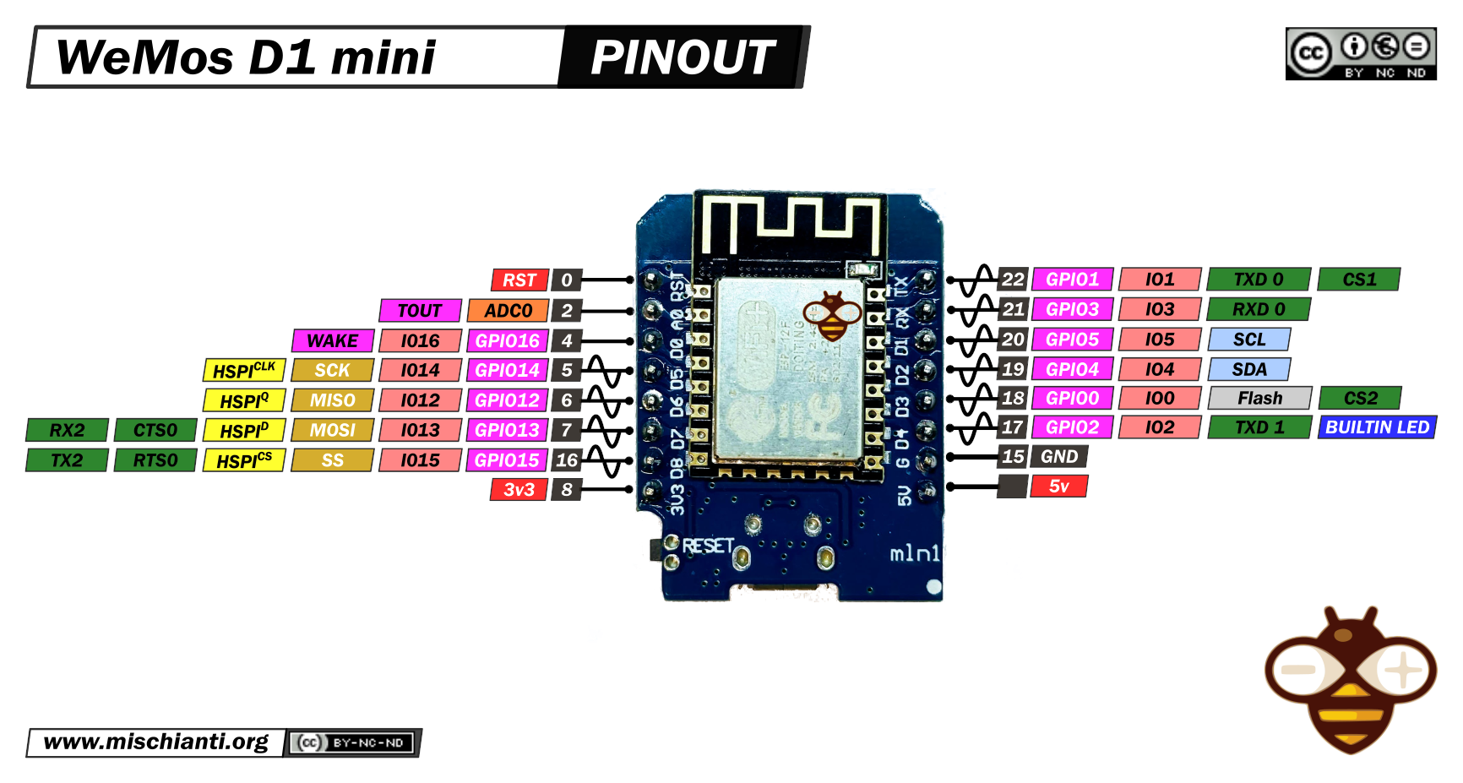
Our Microcontroller: The WeMos D1 Mini
Hilights
11 digital IO: all are interrupt and pwm capable (except D0/GPIO16)
1 analog input (3.2V max input): A0/ADC0
Micro USB or Type-C USB Port (clones usually have micro USB)
Two SPI interfaces (one is used for on-board flash memory), one I2C interface, two serial ports
Built-in WiFi (client or standalone access point modes) and Bluetooth
Compatible with MicroPython, Arduino, NodeMCU
Uses the CH340 USB-to-serial driver (installation usually needed on Windows)
Extremely low cost (approx $3.00 US on Amazon; one of the two least expensive components in your kits)

Slide 19
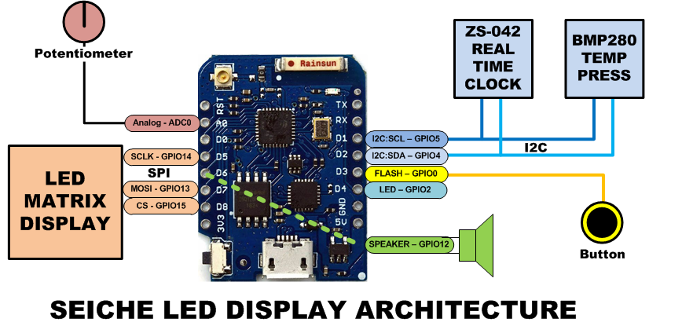
SEICHE LED Display Architecture
Red MAX7219 8x32 LED matrix display (SPI)
ZS-042 real-time clock module (I2C)
BMP280 Temperature and Pressure Sensor (I2C)
Piezoelectric speaker (PWM)
10KΩ Potentiometer (Analog-to-Digital Converter)
Button (Pullup and interrupt)

Slide 20
sprintf() Function Syntax
sprintf()’s formal syntax is: sprintf(char *buffer, const char *format, variable list)
buffer is an array of type char (the parameter when passed can also be a pointer [address] for such an array) which will contain the formatted output of the function
format is an unmodifiable (constant) array of char containing the format descriptors for all variables subsequently passed to the function, which is to say, it’s the format string.
The variable list are just the comma separated variables that are to be formatted
All variables passed in a single call to sprintf() are combined into a single output string
sprintf() automagically puts a terminating NULL (\0) at the end of the ASCII output

Slide 21
sprintf() Format Strings
sprintf() format strings contain conversion specifiers that specify how each individual variable is to be converted
sprintf() conversion specifiers have the following general syntax (all begin with a percent-sign):
%[flags][minimum field width][.][precision][length][conversion character]
% - special token that indicates the start of a conversion specifier
Flags – these modify the behavior of the specification
Minumum field width – as it says on the tin; this the minimum number of characters to be converted
. – The period is a separator between field width and precision
Precision – means one of the following depending on the variable type and conversion specifier
The maximum number of characters to be generated from a string
The number of digits after the decimal point for type float conversions (e, E, or f)
The zero-filled minimum number of digits for an integer
Conversion character – A single character which determines the output type of the conversion specifier; a single character that specifies the type of output format for the corresponding data or variable

Slide 22
sprintf() Conversion Specifiers
Below are the general conversion specifiers and what they do.
Specifier | What it does
d, i | int - integer; signed decimal notation
o | int – unsigned octal (no leading zero)
x, X | int – unsigned hexadecimal, no leading 0x
u | int – unsigned decimal
c | int – single character, after conversion to unsigned char
s | char * - characters from string are printed until \0 (NULL) or precision is reached
f | double – decimal notation of form [-]mmm.ddd where number of decimals is specified by precision; precision of zero (0) suppresses the decimals altogether
e, E | double - exp notation; default precision of 6, 0 suppresses
g, G | double – Use %f for <10^4 or %e for >10^4
p | void * - print output as a pointer, platform dependent
n | Number of characters generated so far; goes into output
% | No conversion, put a % percent sign in the output

Slide 23
sprintf() Conversion Specifiers
Below are the flags and what they do.
Flag | What it does
- | Left justification
+ | Always print number with a sign
spc (space) | Prefix a space if first character is not a sign
0 (zero) | Zero fill left for numeric conversions
# | Alternate output form depending on conversion character o – first digit will be zero x or X – 0x or 0X (respectively) prefixed to non-zero results e, E, f, g and G – Output will always have a decimal point g and G – trailing zeroes will never be removed

